Slide 1
Energy

Slide 2
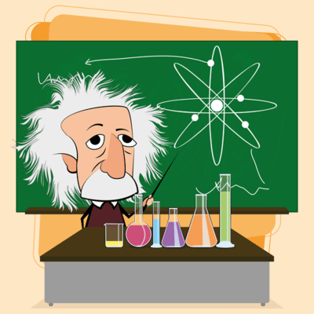
In this Smart Lesson you will learn to:
Describe energy in terms of electron volts (eV) and Joules (J).
Recall Einstein's mass-energy equivalence relationship.
Solve problems involving Einstein's mass-energy equivalence relationship.

Slide 3
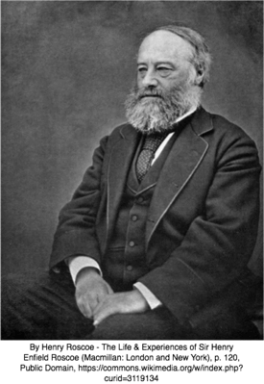
You are probably familiar with the SI unit of energy - the Joule.
This is defined as the energy transferred to an object when a force of one Newton acts in the direction of movement for a distance of one metre. The unit was named after an English Physicist, James Joule, who famously studied the relationships between heat and work.
When working on an atomic scale, the Joule is too large a unit to be helpful in calculations. Instead we often use the unit called an electron Volt (eV). This is defined as a unit of energy equal to the work done on an electron in accelerating it through an electrical potential difference of 1 volt.

Slide 4
So how much energy is an electron Volt?
1eV≈1.602×10⁻¹⁹J
Atomic properties such as ionisation energies are usually quoted in eV.
As there are often large numbers of electron Volts, prefixes may be used:
1MeV is 1 mega electron Volt, or 1×10⁶eV.
1GeV is 1 giga electron Volt, or 1×10⁹eV.

Slide 5
You've heard a lot about the Conservation of Energy - specifically that energy can not be created or destroyed - and the Conservation of Mass.
However, something unexpected happens in the nucleus of the atom.

Slide 6
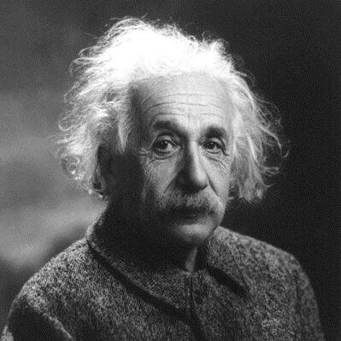
The sum of the masses of the individual nucleons is more than the mass of the nucleus.
How does this happen?
The answer lies in Einstein's famous equation: ΔE=Δmc². This equation states that mass is a form of energy, just like kinetic energy or heat energy. This explains why the missing mass, called the mass defect (Δm), was transformed into energy.

Slide 7
Einstein's mass-energy equivalence relationship.
ΔE=Δmc²
In this famous equation, ΔE represents a change in energy.
Δm is change in mass.
c is the speed of light, which is a constant.
c≈3×10⁸ ms⁻¹

Slide 8
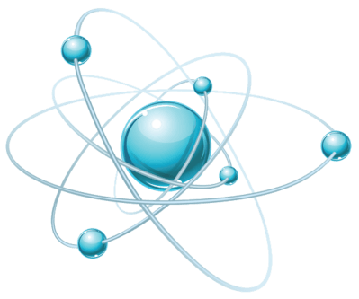
The mass defect is converted into energy.
This energy, called the nuclear binding energy, is the energy needed to break the nucleus into the nucleons that make it up.
The nuclear binding energy per nucleon can be used as a measure of stability. A stable nucleus has more binding energy per nucleon than an unstable nucleus.

Slide 9
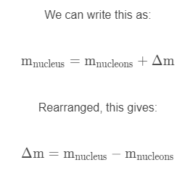
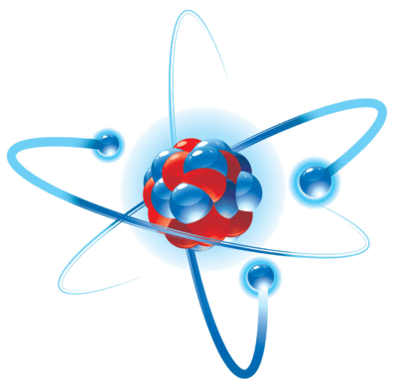
The mass defect is the difference between the mass of the nucleus and the mass of the nucleons which make it up.

Slide 10
Binding energy is defined as the mechanical work that must be done against the forces holding a nucleus together to disassemble it into component parts
We find the binding energy of a nucleus with the E=Δmc² formula.
c is the speed of light.
c≈3.00×10⁸ ms⁻¹
The energy is always negative, because it is being released from the nucleus.

